Slide 1
Azure Machine Learning on Databricks
Seth Mottaghinejad
sethmott@microsoft.com
Wolfgang Pauli, PhD
wolfgang.pauli@microsoft.com

Slide 2
Agenda
Azure Databricks
Azure Machine Learning
AML Integration with Databricks
AutoML

Slide 3
Azure Databricks

Slide 4
What is Azure Databricks?
A fast, easy and collaborative Apache® Spark™ based analytics platform optimized for Azure
Designed in collaboration with the founders of Apache Spark
One-click set up; streamlined workflows
Interactive workspace that enables collaboration between data scientists, data engineers, and business analysts.
Native integration with Azure services (Power BI, SQL DW, Cosmos DB, Blob Storage)
Enterprise-grade Azure security (Active Directory integration, compliance, enterprise -grade SLAs)
Best of Databricks
Best of Microsoft

Slide 5
Why Spark?
Open-source data processing engine built around speed, ease of use, and sophisticated analytics
In memory engine that is up to 100 times faster than Hadoop
Largest open-source data project with 1000+ contributors
Highly extensible with support for Scala, Java and Python alongside Spark SQL, GraphX, Streaming and Machine Learning Library

Slide 6
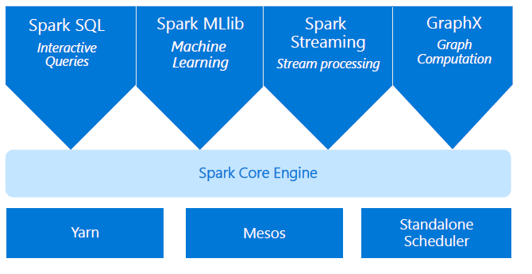
Apache Spark
An unified, open source, parallel, data processing framework for Big Data Analytics
Spark Unifies:
Batch Processing
Interactive SQL
Real-time processing
Machine Learning
Deep Learning
Graph Processing

Slide 7
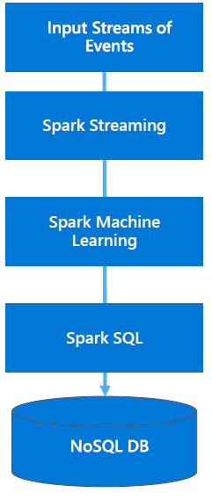
Advantages of a Unified Platform
Improves developer productivity—a single consistent set of APIs
All different systems in Spark share the same abstraction — RDDs (Resilient Distributed Datasets)
Developers can mix and match different kind of processing in the same application. This is a common requirement for many big data pipelines
Performance improves because unnecessary movement of data across engines is eliminated. In many pipelines, data exchange between engines is the dominant cost

Slide 8
Differentiated experience on Azure
ENHANCE PRODUCTIVITY
Get started quickly by launching
your new Spark environment with one click
Share your insights in powerful
ways through rich integration with Power BI
Improve collaboration amongst
your analytics team through a
unified workspace
Innovate faster with native
integration with rest of Azure
platform
BUILD ON THE MOST COMPLIANT CLOUD
Simplify security and identity control
with built-in integration with Active
Directory
Regulate access with fine-grained user permissions to Azure Databricks’
notebooks, clusters, jobs and data
Build with confidence on the trusted
cloud backed by unmatched support,
compliance and SLAs
SCALE WITHOUT LIMITS
Operate at massive scale without limits globally
Accelerate data processing with the fastest Spark engine

Slide 9
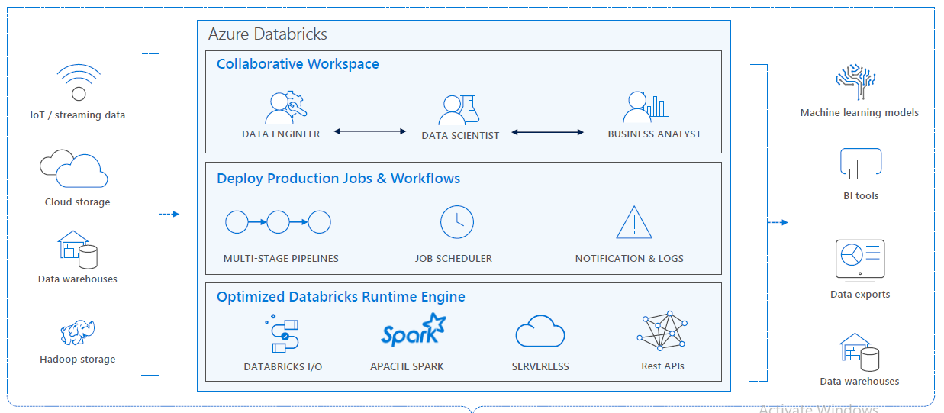
Azure Databricks
Enhance Productivity
Build on secure & trusted cloud
Scale without limits

Slide 10
Azure Machine Learning

Slide 11
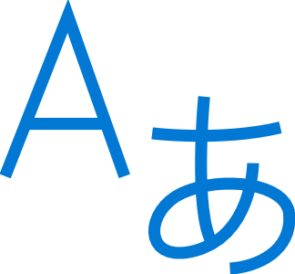
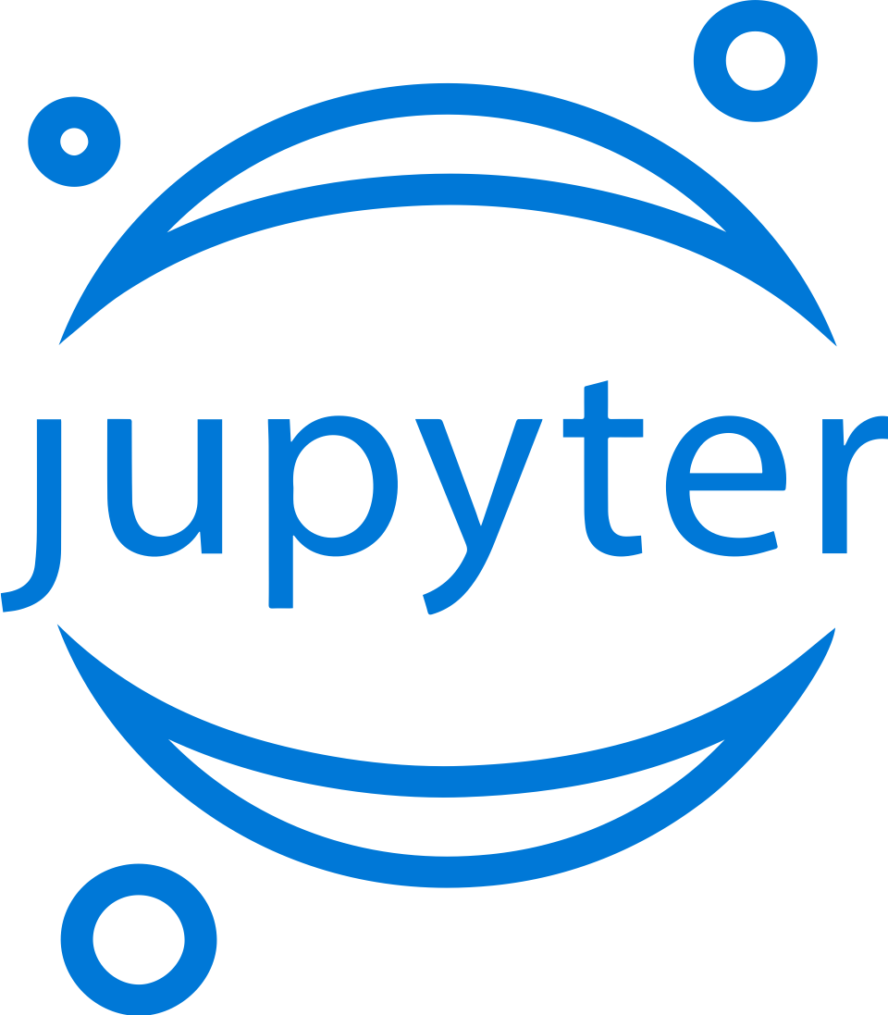
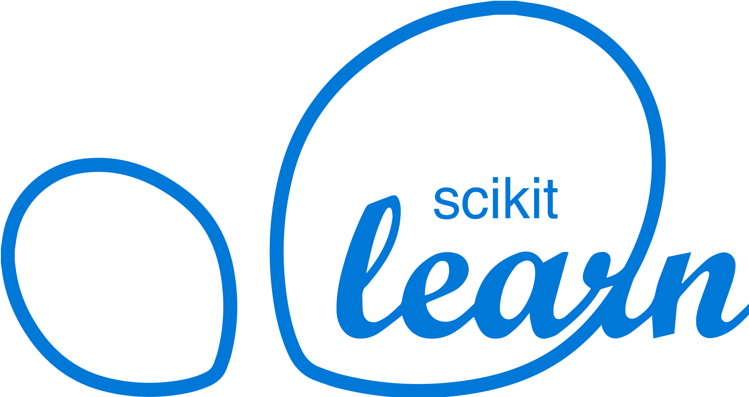
Machine Learning on Azure
Domain Specific Pretrained Models
To reduce time to market
…
Vision
Speech
Language
Search
Familiar Data Science Tools
To simplify model development
PyCharm
Jupyter
Visual Studio Code
Command line
Popular Frameworks
To build machine learning and deep learning solutions
PyTorch
TensorFlow
Scikit-Learn
ONNX
Productive Services
To empower data science and development teams
Azure Databricks
Azure Machine Learning
Machine Learning VMs
Powerful Infrastructure
To accelerate deep learning
CPU
GPU
FPGA
From the Intelligent Cloud to the Intelligent Edge

Slide 12
Azure Machine Learning Service
Bring AI to everyone with an end-to-end, scalable, trusted platform
Built with your needs in mind
Boost your data science productivity
Automated machine learning
Managed compute
Increase your rate of experimentation
DevOps for machine learning
Simple deployment
Tool agnostic Python SDK
Deploy and manage your models everywhere
Support for open source frameworks
Seamlessly integrated with the Azure Portfolio
Notes:
Azure Machine Learning Services empowers you to bring AI to everyone with an end-to-end, scalable, trusted platform.
Boost your data science productivity
Python pip-installable extensions for Azure Machine Learning that enable data scientists to build and deploy machine learning and deep learning models
Now available for Computer Vision, Text Analytics and Time-Series Forecasting.
Increase your rate of experimentation
Rapidly prototype on your desktop, then easily scale up on virtual machines or scale out using Spark clusters
Proactively manage model performance, identify the best model, and promote it using data-driven insights
Collaborate and share solutions using popular Git repositories.
Deploy and manage your models everywhere
Use Docker containers to deploy models into production faster in the cloud, on-premises, or at the edge
Promote your best performing models into production and retrain them when their performance degrades
Azure Machine Learning Services are built with your needs in mind, providing:
GPU-enabled virtual machines
Low-latency predictions at scale
Integration with popular Python IDEs
Role-based access controls
Model versioning
Automated model retraining
(Optional: other services)
Azure Machine Learning Workbench integrates with ONNX models
Work with your ONNX models from Visual Studio Code Tools for AI.
Build deep learning models and call services straight from your favorite IDE easier with Azure Machine Learning services built right in.
Create a seamless developer experience across desktop, cloud, or at the edge.
AI Toolkit for Azure IoT Edge
MMLSpark is an open-source Spark package that enables you to quickly create powerful, highly-scalable predictive and analytical models for large image and text datasets by using deep learning and data science tools for Apache Spark.
Azure Machine Learning Services seamlessly integrates with the rest of the Azure portfolio.
<Transition>: Azure Machine Learning Services allows you to deploy models to many different production environments.

Slide 13
AML Integration with Databricks

Slide 14
AML SDK + Databricks
End-to-end custom Machine Learning
Easily install the SDK in Azure Databricks clusters
Use the SDK for:
Logging training run metrics
Containerize Spark ML models
Deploy them into ACI or AKS, just like any other models.
Automated ML (public preview) of Azure ML SDK with Azure Databricks

Slide 15
AML SDK + Databricks
Azure Databricks Cluster to run experiments with or without automated machine learning:
azureml-sdk[databricks]
azureml-sdk[automl_databricks
Leverage the local worker nodes with autoscale and auto termination capabilities:
Autoscaling
Cluster size is automatically adjusted between minimum and maximum number of worker limits during the cluster’s lifetime.
During runtime, Databricks dynamically reallocates workers to account for the characteristics of your job.
Certain parts of your pipeline may be more computationally demanding than others.
Databricks automatically adds additional workers during these phases of your job.
Notes:
Azure Databricks monitors load on Spark clusters and decides whether to scale a cluster up or down and by how much.

Slide 16
AML SDK + Databricks
Multiple cores of your Azure Databricks cluster to perform simultaneous training
Tune the model generated by automated machine learning if you chose to
Every run (including the best run) is available as a pipeline, which you can tune further if needed
The model trained using Azure Databricks can be registered in Azure ML SDK workspace
Registered model can then be deployed to Azure managed compute (ACI or AKS) using the Azure Machine learning SDK

Slide 17
AutoML

Slide 18
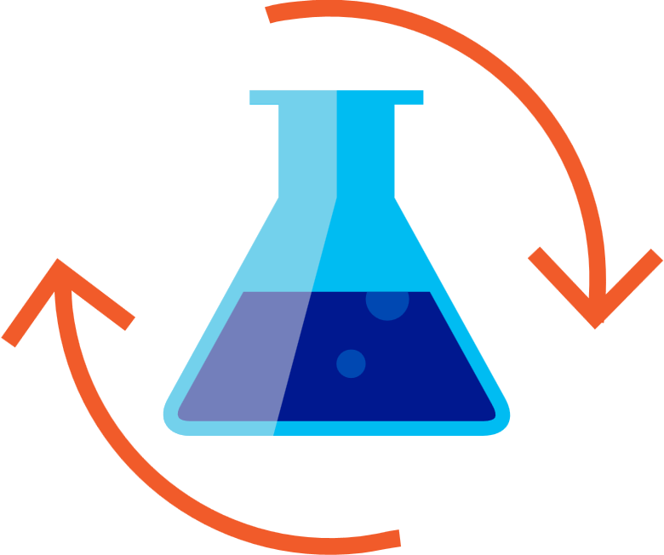
Machine Learning Process
SQL DB
Cosmos DB
Datawarehouse
Data lake
Blob storage
…
Prepare Data
Build & Train
Deploy

Slide 19
Machine Learning Problem Example
How much is this car worth?

Slide 20
Model Creation Is Typically Time-Consuming
Which features?
Which algorithm?
Which parameters?
Mileage
Condition
Car brand
Year of make
Regulations
…
Gradient Boosted
Nearest Neighbors
SVM
Bayesian Regression
LGBM
…
Parameter 1
Parameter 2
Parameter 3
Parameter 4
…
Mileage
Gradient Boosted
Condition
Nearest Neighbors
Car brand
Car brand
50%
Year of make
30%
Year of make
Model
Iterate

Slide 21
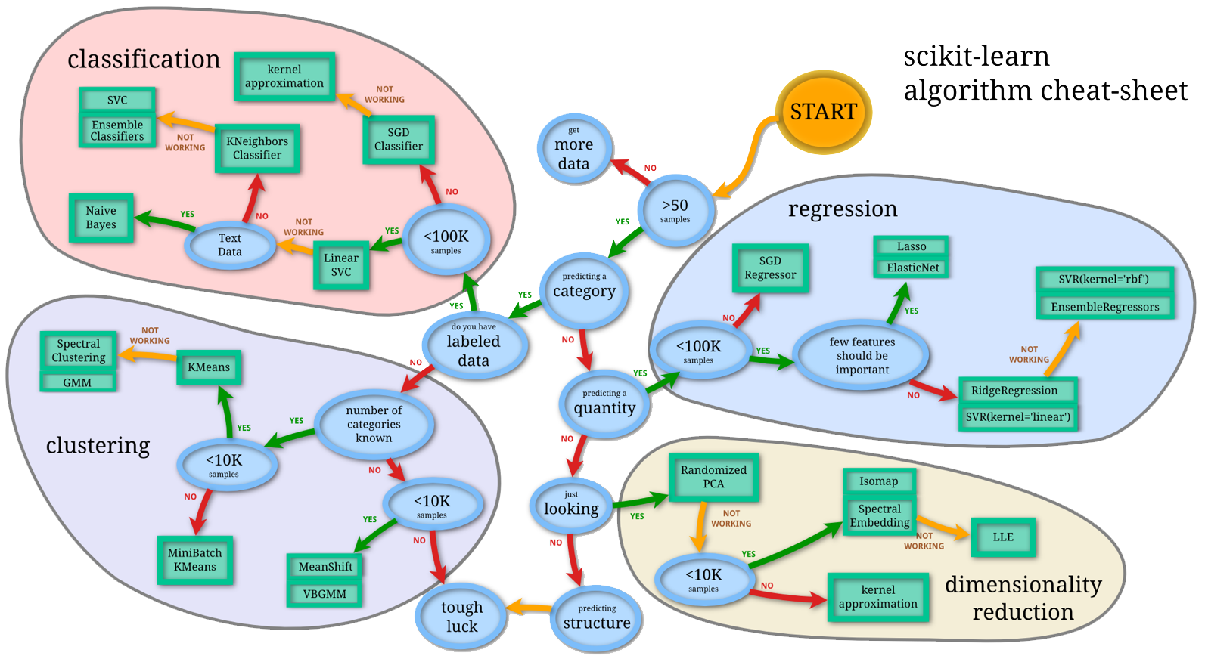
Machine Learning Complexity
Source: http://scikit-learn.org/stable/tutorial/machine_learning_map/index.html

Slide 22
Model Selection & Hyperparameter Tuning
Dataset
Model Training
Infrastructure
Training Algorithm 1
Training Algorithm 2
Model 1
Model 2
Model 3
Model 4
Hyperparameter
Values – config 1
Hyperparameter
Values – config 2
Hyperparameter
Values – config 3
Repetitive & Manual
Hyperparameter
Values – config 4

Slide 23
Introducing Automated Machine Learning
Dataset
Optimization
Metric
Automated ML
ML Model
Constraints
(Time/Cost)
Accessible & Faster

Slide 24
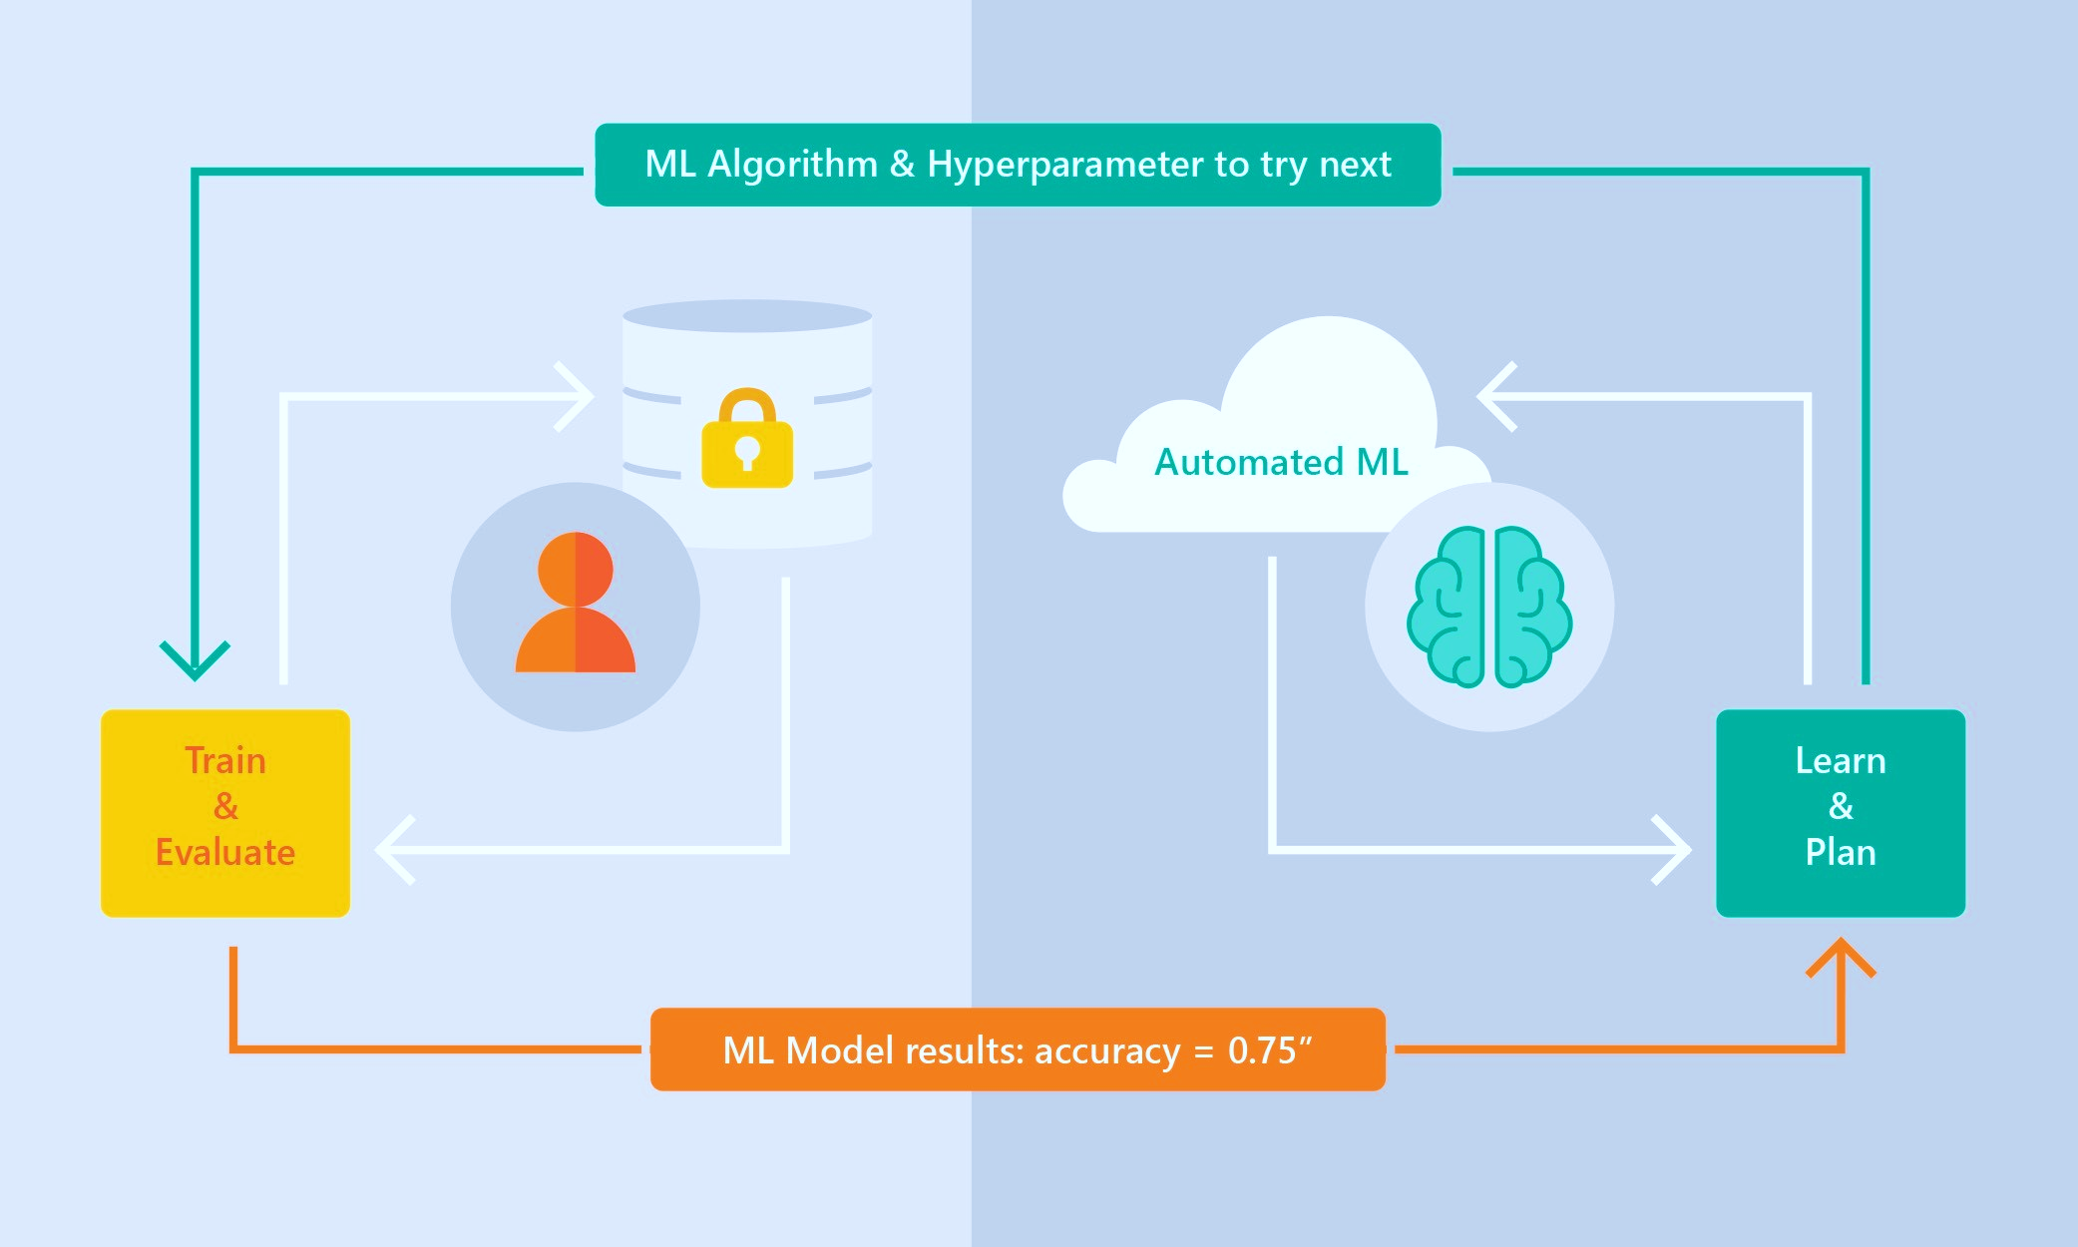
Automated ML Capabilities
Based on Microsoft Research
Brain trained with several million experiments
Collaborative filtering and Bayesian optimization
Privacy preserving: No need to “see” the data

Slide 25
Automated ML Capabilities
ML Scenarios: Classification & Regression
Integration: Azure Machine Learning, Azure Notebooks, Jupyter Notebooks
Data Type: Numeric, Text
Languages: Python SDK for deployment and hosting for inference
Training Compute: Local Machine, Remote Azure DSVM (Linux), Azure Batch AI
Transparency: View run history, model metrics
Scale: Faster model training using multiple cores and parallel experiments

Slide 26
Demo

